Slide 1
Analyzing the Short-term Rental Market: An Advanced Statistical Analysis
Stat 4010-5010
Anila Reddy Musku
Mohammed Junaid shaik

Slide 2
Contents of This presentation :
Introduction & main motivation
Data
Exploratory Data Analysis (EDA)
Methods –
4.1 ANOVA
4.2 Multiple linear regression Model
4.3 Generalized Linear Model
4.4 Ridge Regression
4.5 Generalized Additive Model
Evaluation
Conclusion

Slide 3

INTRODUCTION :
We opted to utilize data from Airbnb for our analysis in this project.. Airbnb is an online platform that enables property owners to rent out their spaces to travelers looking for a place to stay.
Airbnb lets property owners rent out their spaces to travelers for multiple people, shared space with private rooms, or the entire property. It provides the opportunity to experience local life and stay in unique accommodations such as bungalows, boathouses, mansions, and castles.
Hosts make money by allowing guests to stay in their spaces, and guests can enjoy amenities like full kitchens, laundry machines, and TVs. Airbnb is like a home away from home, offering a glimpse into how locals live.
In this presentation, we will analyze the short-term rental market in Portland city using Airbnb data, using advanced statistical analysis techniques to understand its dynamics and implications.
So, this analysis is useful for the people who travel more and for the people who looking to invest in short-term rental properties, and this helps to enhance their business strategies. Also, when a traveler is looking for places to stay

Slide 4
Main motivation :
The main motivation for this analysis is to gain a better understanding of the short-term rental market in Portland city using Airbnb data, and its impact on the prices by considering various factors .
Specifically, we aim to answer the following questions:
1. To predict price of listings
2. To find the most important factors that affect the price
3. Which statistical learning tools works best for predicting the price?
4. What is the relationship between the price of a listing and its location, amenities, and other factor?
The price of a listing changes with the neighborhood, amenities provided, number of rooms, type of property. A proper analysis into all the features is required to find the perfect vacation stay for travelers.
As profitable Investing in Airbnb properties may look, there could be huge losses if a host does not know what features he needs to invest in his rental home.

Slide 5
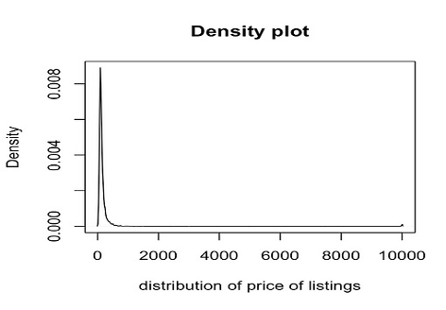
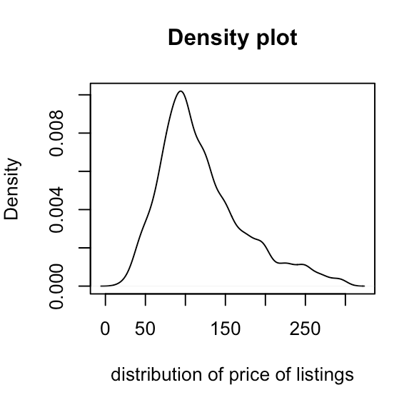
DATA :
Inside Airbnb is a mission driven project that provides data and advocacy about Airbnb's impact on residential communities. These website has all the data about Airbnb listings sorted state wise. we decided to work on the Airbnb's in Portland.
The listings dataset includes the bulk of the data — listing name, locations (latitude/longitude), neighborhood, host, room type, price, minimum nights a listing must be booked for, number of reviews for that listing, date of last review, average reviews per month, availability (how many days out of 365 the listing is available for booking), and number of listings per host.
Data cleaning :
when comes to data cleaning, there are a lot of unnecessary variables and outliers in our dataset which are not useful for analyzing and predicting the prices and removing the features which do not impact the price.
The density plot of price looks to be positively skewed, which may be due to outliers. Another peak may be seen around the price range of $10,000.

Slide 6
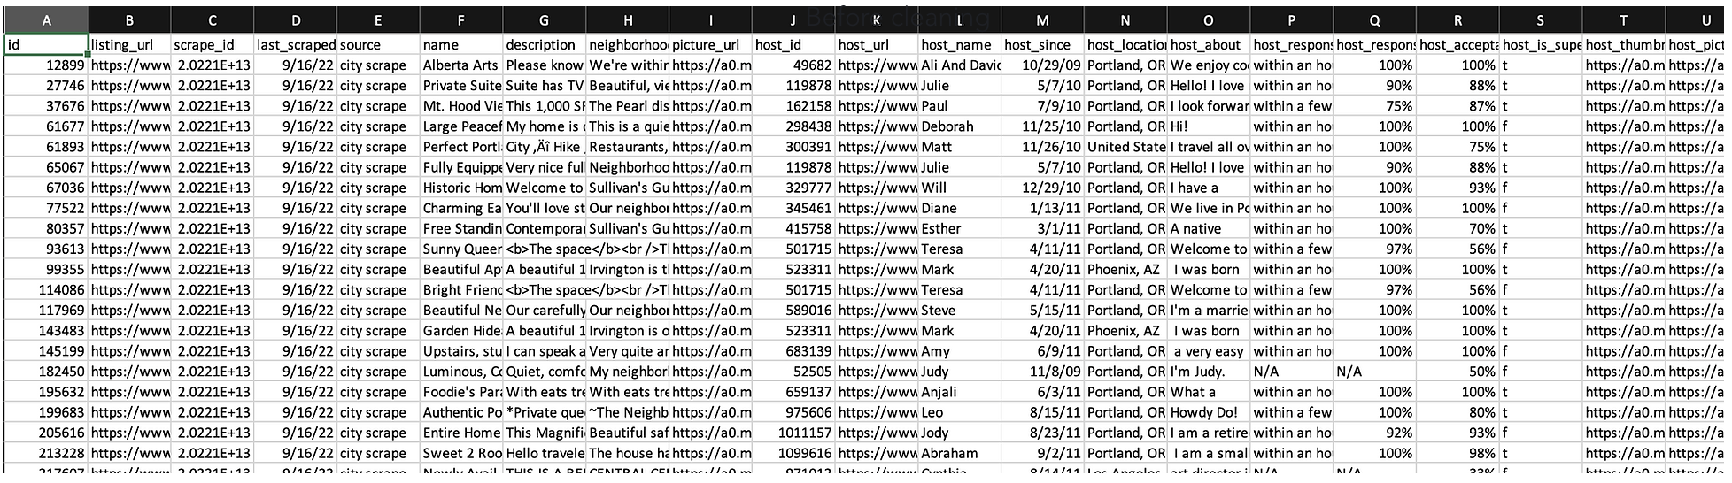
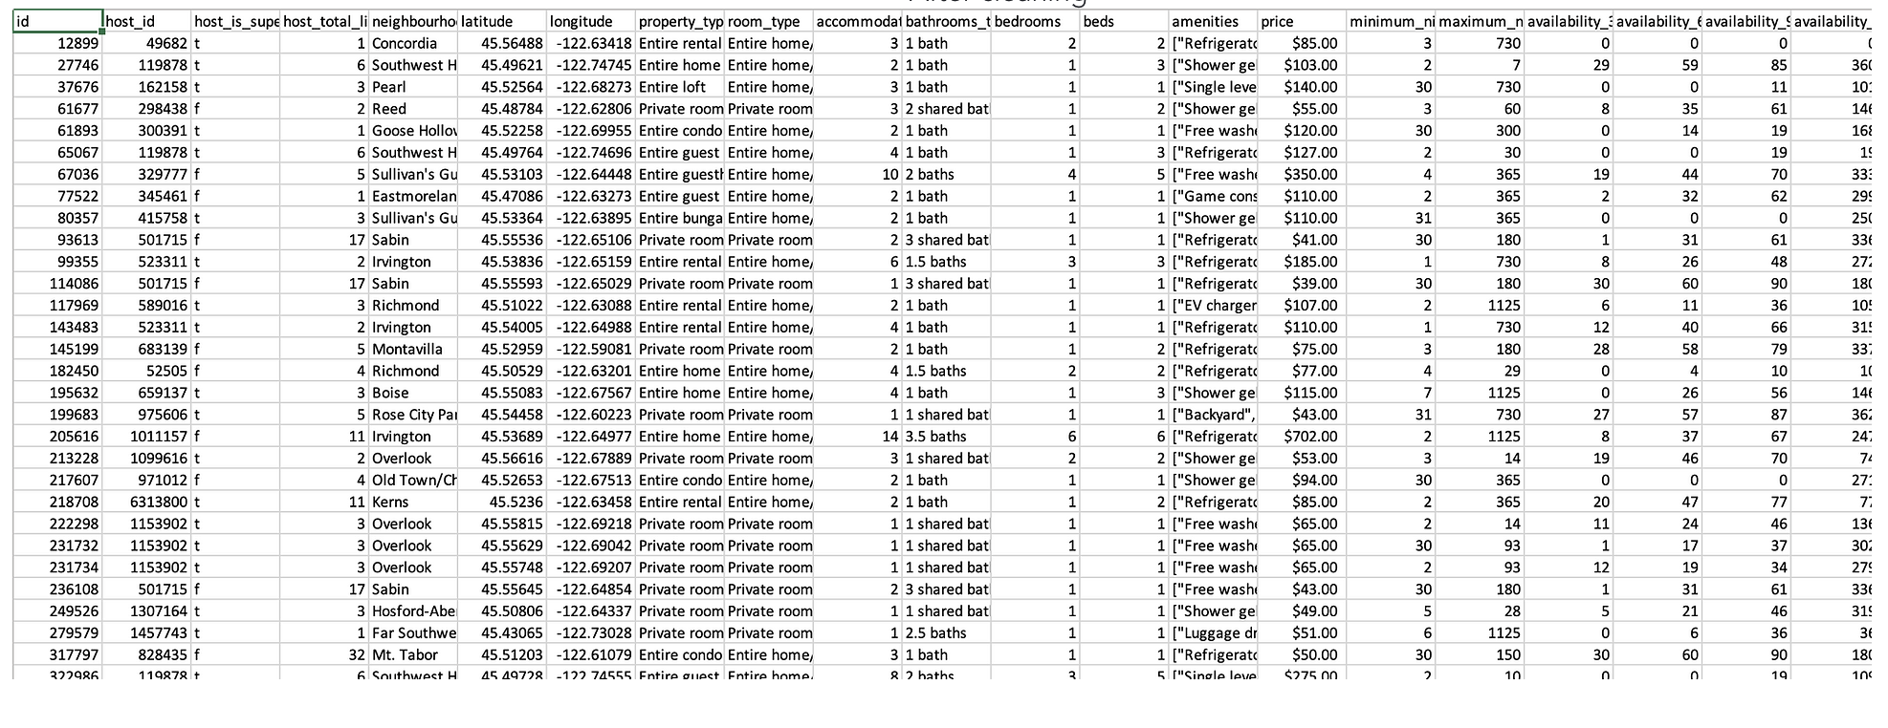
Before cleaning :
After cleaning :

Slide 7
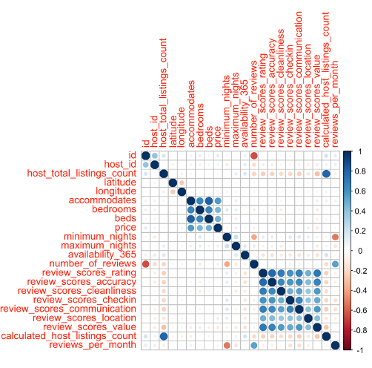
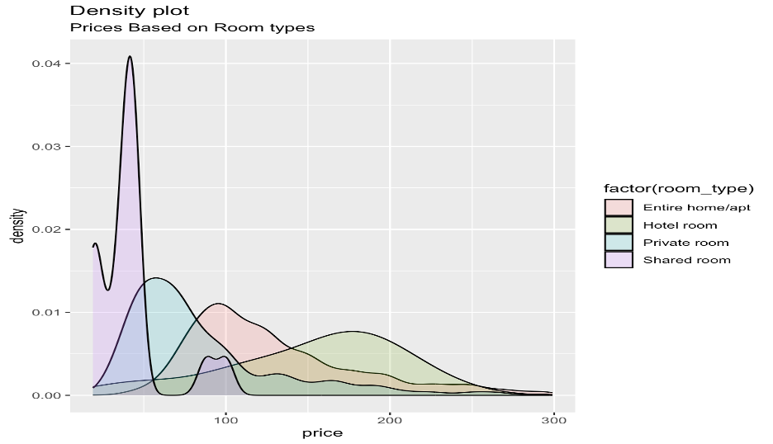
Exploratory Data Analysis :

Slide 8
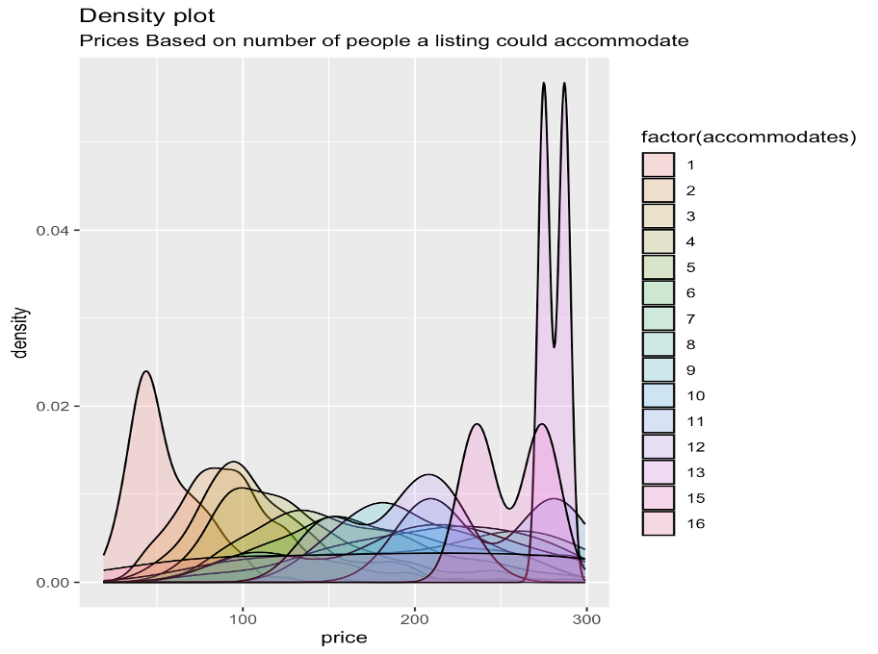
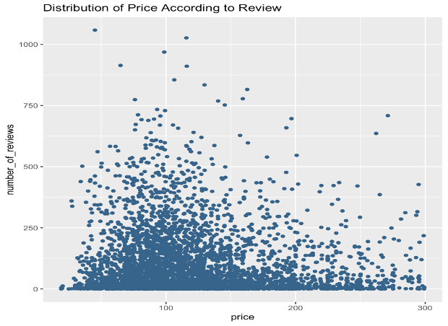

Slide 9
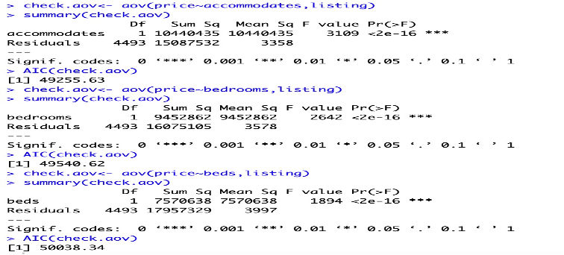
ANOVA :
Through the summary generated by the ANOVA test. we observed that the independent variables (accommodates, bedrooms, beds) had higher F- score value and lower AIC than other variables. From this we can say that there is more correlation between
price vs accommodates
price vs bedrooms
price vs beds

Slide 10
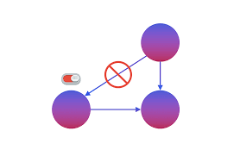
Causality:
Causality refers to a relationship in which one variable directly influences the other variable.
As per the correlation plots, we see that accommodates more correlates the price, but we cannot predict assumptions that accommodates causes price.
In case of observational studies as we cannot manipulate the variables of interest, here price to establish a cause-and-effect relationship, we cannot test for causality based on the data collected.
In our case, we first try to check for relationships between our predictor variables like bedrooms, accommodates, beds, room type, number of reviews and the response variable price using regression models. Using these regression models, we try to control for other factors that may affect the outcome. But, based on upon these analyses, we cannot establish causality.

Slide 11
Linear Regression :
Price Regression Analysis
In this analysis we tried to predict the price and we are training the dataset with the ratio of 80:20
Model 3 was the best model among all the linear models that we have performed. The independent variables for this model are accommodates, bedrooms, number_of_reviews, reviews_per_month, minimum_nights , latitude ,longitude , beds , room_type, calculated_host_listings_count.
 | Model1 | Model2 | Model3
AIC | 33108 | 33052 | 33035
BIC | 33181 | 33143 | 33126
Adjusted R2 | 0.393 | 0.4039 | 0.4071

Slide 12
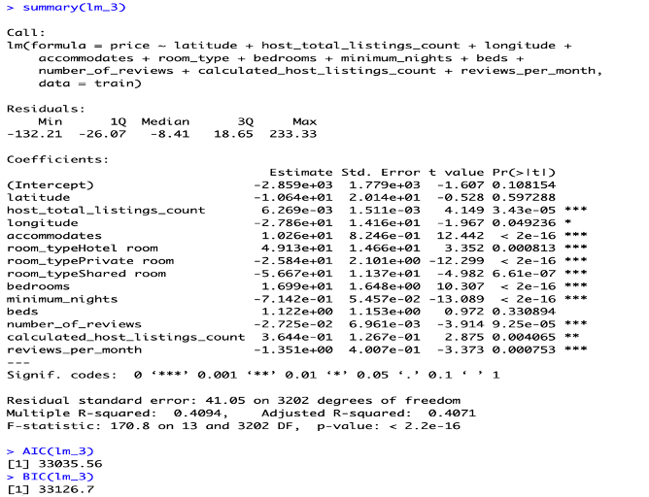
From the summary of model 3, we could say that “accommodates”, “Private room type”, “bedrooms”, “minimum nights”, “number_of_reviews”, and “host_total_listings_count” are the most important to the price. Some are negative correlation, and some are positive correlation ones.

Slide 13
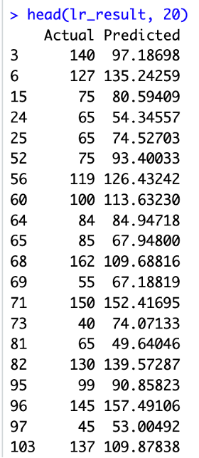
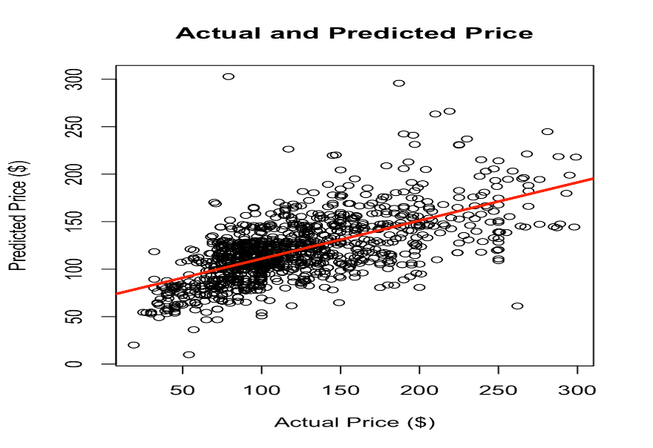
Prediction :
Model 3 would likely be the best model to use for prediction.

